Slide 1
Data Mining: Concepts and Techniques (3rd ed.) — Chapter 13 —
Jiawei Han, Micheline Kamber, and Jian Pei
University of Illinois at Urbana-Champaign &
Simon Fraser University
©2011 Han, Kamber & Pei. All rights reserved.
Notes:
‹#›

Slide 2


Slide 3
Chapter 13: Data Mining Trends and Research Frontiers
Mining Complex Types of Data
Other Methodologies of Data Mining
Data Mining Applications
Data Mining and Society
Data Mining Trends
Summary
‹#›

Slide 4
Mining Complex Types of Data
Mining Sequence Data
Mining Time Series
Mining Symbolic Sequences
Mining Biological Sequences
Mining Graphs and Networks
Mining Other Kinds of Data
‹#›

Slide 5
Mining Sequence Data
Similarity Search in Time Series Data
Subsequence match, dimensionality reduction, query-based similarity search, motif-based similarity search
Regression and Trend Analysis in Time-Series Data
long term + cyclic + seasonal variation + random movements
Sequential Pattern Mining in Symbolic Sequences
GSP, PrefixSpan, constraint-based sequential pattern mining
Sequence Classification
Feature-based vs. sequence-distance-based vs. model-based
Alignment of Biological Sequences
Pair-wise vs. multi-sequence alignment, substitution matirces, BLAST
Hidden Markov Model for Biological Sequence Analysis
Markov chain vs. hidden Markov models, forward vs. Viterbi vs. Baum-Welch algorithms
‹#›

Slide 6
Mining Graphs and Networks
Graph Pattern Mining
Frequent subgraph patterns, closed graph patterns, gSpan vs. CloseGraph
Statistical Modeling of Networks
Small world phenomenon, power law (log-tail) distribution, densification
Clustering and Classification of Graphs and Homogeneous Networks
Clustering: Fast Modularity vs. SCAN
Classification: model vs. pattern-based mining
Clustering, Ranking and Classification of Heterogeneous Networks
RankClus, RankClass, and meta path-based, user-guided methodology
Role Discovery and Link Prediction in Information Networks
PathPredict
Similarity Search and OLAP in Information Networks: PathSim, GraphCube
Evolution of Social and Information Networks: EvoNetClus
‹#›

Slide 7
Mining Other Kinds of Data
Mining Spatial Data
Spatial frequent/co-located patterns, spatial clustering and classification
Mining Spatiotemporal and Moving Object Data
Spatiotemporal data mining, trajectory mining, periodica, swarm, …
Mining Cyber-Physical System Data
Applications: healthcare, air-traffic control, flood simulation
Mining Multimedia Data
Social media data, geo-tagged spatial clustering, periodicity analysis, …
Mining Text Data
Topic modeling, i-topic model, integration with geo- and networked data
Mining Web Data
Web content, web structure, and web usage mining
Mining Data Streams
Dynamics, one-pass, patterns, clustering, classification, outlier detection
‹#›

Slide 8
Chapter 13: Data Mining Trends and Research Frontiers
Mining Complex Types of Data
Other Methodologies of Data Mining
Data Mining Applications
Data Mining and Society
Data Mining Trends
Summary
‹#›

Slide 9
Other Methodologies of Data Mining
Statistical Data Mining
Views on Data Mining Foundations
Visual and Audio Data Mining
‹#›

Slide 10
Major Statistical Data Mining Methods
Regression
Generalized Linear Model
Analysis of Variance
Mixed-Effect Models
Factor Analysis
Discriminant Analysis
Survival Analysis
‹#›

Slide 11
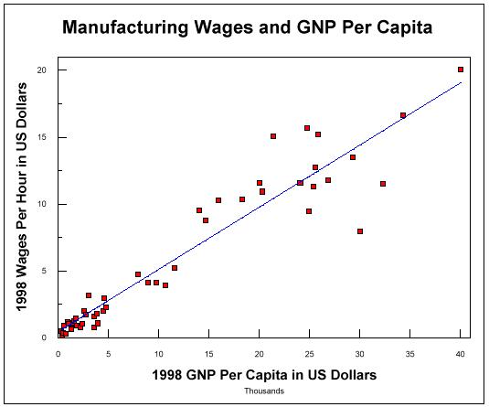
Statistical Data Mining (1)
There are many well-established statistical techniques for data analysis, particularly for numeric data
applied extensively to data from scientific experiments and data from economics and the social sciences
Regression
predict the value of a response (dependent) variable from one or more predictor (independent) variables where the variables are numeric
forms of regression: linear, multiple, weighted, polynomial, nonparametric, and robust
‹#›

Slide 12
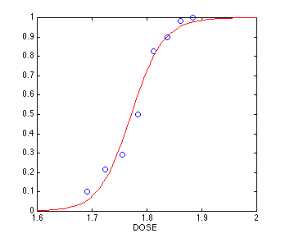
Scientific and Statistical Data Mining (2)
Generalized linear models
allow a categorical response variable (or some transformation of it) to be related to a set of predictor variables
similar to the modeling of a numeric response variable using linear regression
include logistic regression and Poisson regression
Mixed-effect models
For analyzing grouped data, i.e. data that can be classified according to one or more grouping variables
Typically describe relationships between a response variable and some covariates in data grouped according to one or more factors
‹#›

Slide 13
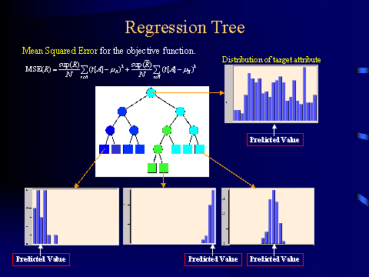
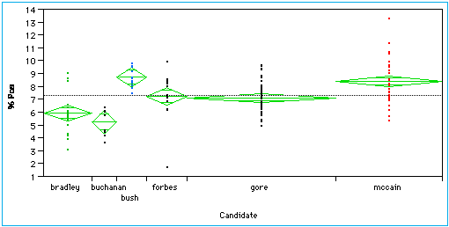
Scientific and Statistical Data Mining (3)
Regression trees
Binary trees used for classification and prediction
Similar to decision trees:Tests are performed at the internal nodes
In a regression tree the mean of the objective attribute is computed and used as the predicted value
Analysis of variance
Analyze experimental data for two or more populations described by a numeric response variable and one or more categorical variables (factors)
‹#›
Notes:
‹#›
Mixed-effects models provide a powerful and flexible tool for the analysis of balanced and unbalanced grouped data. These data arise in several areas of investigation and are characterized by the presence of correlation between observations within the same group. Some examples are repeated measures data, longitudinal studies, and nested designs. Classical modeling techniques which assume independence of the observations are not appropriate for grouped data.

Slide 14
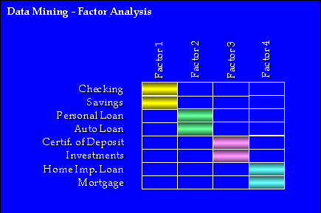
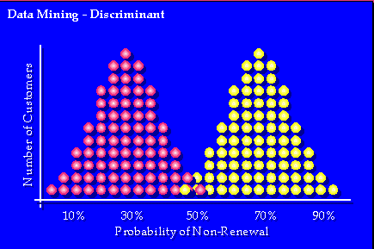
Statistical Data Mining (4)
Factor analysis
determine which variables are combined to generate a given factor
e.g., for many psychiatric data, one can indirectly measure other quantities (such as test scores) that reflect the factor of interest
Discriminant analysis
predict a categorical response variable, commonly used in social science
Attempts to determine several discriminant functions (linear combinations of the independent variables) that discriminate among the groups defined by the response variable
www.spss.com/datamine/factor.htm
‹#›

Slide 15
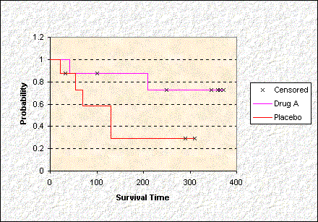
Statistical Data Mining (5)
Time series: many methods such as autoregression, ARIMA (Autoregressive integrated moving-average modeling), long memory time-series modeling
Quality control: displays group summary charts
Survival analysis
Predicts the probability that a patient undergoing a medical treatment would survive at least to time t (life span prediction)
‹#›

Slide 16
Other Methodologies of Data Mining
Statistical Data Mining
Views on Data Mining Foundations
Visual and Audio Data Mining
‹#›

Slide 17
Views on Data Mining Foundations (I)
Data reduction
Basis of data mining: Reduce data representation
Trades accuracy for speed in response
Data compression
Basis of data mining: Compress the given data by encoding in terms of bits, association rules, decision trees, clusters, etc.
Probability and statistical theory
Basis of data mining: Discover joint probability distributions of random variables
‹#›

Slide 18
Views on Data Mining Foundations (II)
Microeconomic view
A view of utility: Finding patterns that are interesting only to the extent in that they can be used in the decision-making process of some enterprise
Pattern Discovery and Inductive databases
Basis of data mining: Discover patterns occurring in the database, such as associations, classification models, sequential patterns, etc.
Data mining is the problem of performing inductive logic on databases
The task is to query the data and the theory (i.e., patterns) of the database
Popular among many researchers in database systems
‹#›

Slide 19
Other Methodologies of Data Mining
Statistical Data Mining
Views on Data Mining Foundations
Visual and Audio Data Mining
‹#›

Slide 20
Visual Data Mining
Visualization: Use of computer graphics to create visual images which aid in the understanding of complex, often massive representations of data
Visual Data Mining: discovering implicit but useful knowledge from large data sets using visualization techniques
Multimedia Systems
Computer Graphics
Human Computer Interfaces
Visual Data Mining
High Performance Computing
Pattern Recognition
‹#›

Slide 21
Visualization
Purpose of Visualization
Gain insight into an information space by mapping data onto graphical primitives
Provide qualitative overview of large data sets
Search for patterns, trends, structure, irregularities, relationships among data.
Help find interesting regions and suitable parameters for further quantitative analysis.
Provide a visual proof of computer representations derived
‹#›

Slide 22
Visual Data Mining & Data Visualization
Integration of visualization and data mining
data visualization
data mining result visualization
data mining process visualization
interactive visual data mining
Data visualization
Data in a database or data warehouse can be viewed
at different levels of abstraction
as different combinations of attributes or dimensions
Data can be presented in various visual forms
‹#›

Slide 23
Data Mining Result Visualization
Presentation of the results or knowledge obtained from data mining in visual forms
Examples
Scatter plots and boxplots (obtained from descriptive data mining)
Decision trees
Association rules
Clusters
Outliers
Generalized rules
‹#›

Slide 24
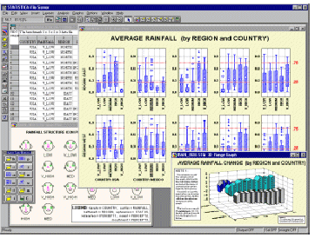
Boxplots from Statsoft: Multiple Variable Combinations
‹#›

Slide 25
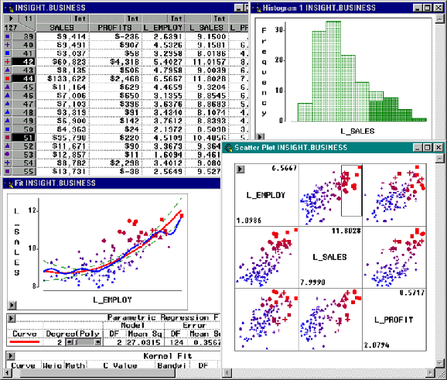
Visualization of Data Mining Results in SAS Enterprise Miner: Scatter Plots
‹#›

Slide 26
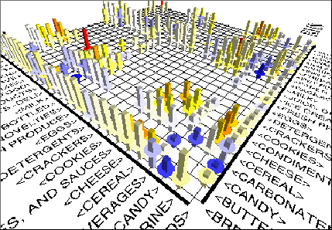
Visualization of Association Rules in SGI/MineSet 3.0
‹#›

Slide 27
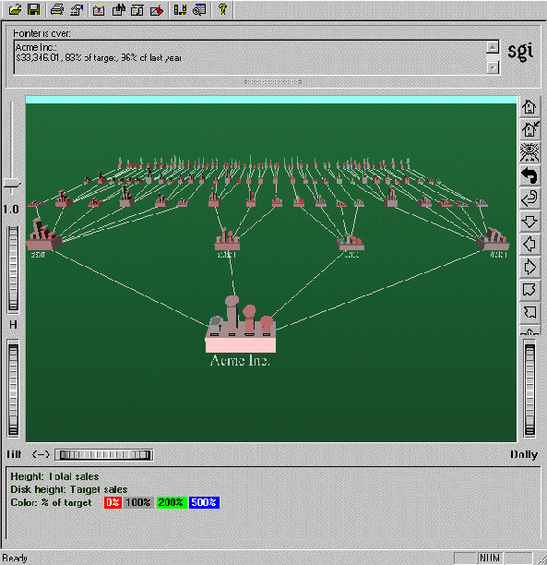
Visualization of a Decision Tree in SGI/MineSet 3.0
‹#›

Slide 28
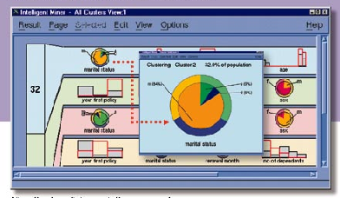
Visualization of Cluster Grouping in IBM Intelligent Miner
‹#›

Slide 29
Data Mining Process Visualization
Presentation of the various processes of data mining in visual forms so that users can see
Data extraction process
Where the data is extracted
How the data is cleaned, integrated, preprocessed, and mined
Method selected for data mining
Where the results are stored
How they may be viewed
‹#›

Slide 30
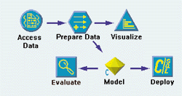
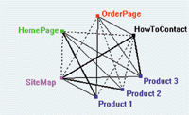
Visualization of Data Mining Processes by Clementine
See your solution discovery process clearly
Understand variations with visualized data
‹#›
Notes:
‹#›
How the interactive Clementine knowledge discovery process works
See your solution discovery process clearly The interactive stream approach to data mining is the key to Clementine's power. Using icons that represent steps in the data mining process, you mine your data by building a stream - a visual map of the process your data flows through. Start by simply dragging a source icon from the object palette onto the Clementine desktop to access your data flow. Then, explore your data visually with graphs. Apply several types of algorithms to build your model by simply placing the appropriate icons onto the desktop to form a stream.
Discover knowledge interactively Data mining with Clementine is a "discovery-driven" process. Work toward a solution by applying your business expertise to select the next step in your stream, based on the discoveries made in the previous step. You can continually adapt or extend initial streams as you work through the solution to your business problem.
Easily build and test models All of Clementine's advanced techniques work together to quickly give you the best answer to your business problems. You can build and test numerous models to immediately see which model produces the best result. Or you can even combine models by using the results of one model as input into another model. These "meta-models" consider the initial model's decisions and can improve results substantially.
Understand variations in your business with visualized data Powerful data visualization techniques help you understand key relationships in your data and guide the way to the best results. Spot characteristics and patterns at a glance with Clementine's interactive graphs. Then "query by mouse" to explore these patterns by selecting subsets of data or deriving new variables on the fly from discoveries made within the graph.
How Clementine scales to the size of the challenge The Clementine approach to scaling is unique in the way it aims to scale the complete data mining process to the size of large, challenging datasets. Clementine executes common operations used throughout the data mining process in the database through SQL queries. This process leverages the power of the database for faster processing, enabling you to get better results with large datasets.

Slide 31
Interactive Visual Data Mining
Using visualization tools in the data mining process to help users make smart data mining decisions
Example
Display the data distribution in a set of attributes using colored sectors or columns (depending on whether the whole space is represented by either a circle or a set of columns)
Use the display to which sector should first be selected for classification and where a good split point for this sector may be
‹#›

Slide 32
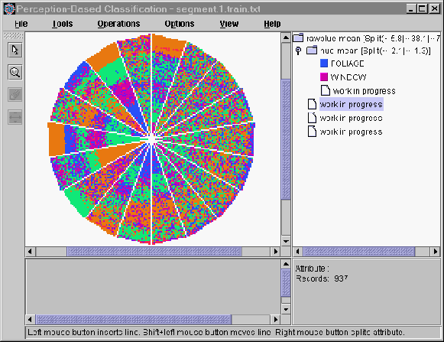
Interactive Visual Mining by Perception-Based Classification (PBC)
‹#›

Slide 33
Audio Data Mining
Uses audio signals to indicate the patterns of data or the features of data mining results
An interesting alternative to visual mining
An inverse task of mining audio (such as music) databases which is to find patterns from audio data
Visual data mining may disclose interesting patterns using graphical displays, but requires users to concentrate on watching patterns
Instead, transform patterns into sound and music and listen to pitches, rhythms, tune, and melody in order to identify anything interesting or unusual
‹#›

Slide 34
Chapter 13: Data Mining Trends and Research Frontiers
Mining Complex Types of Data
Other Methodologies of Data Mining
Data Mining Applications
Data Mining and Society
Data Mining Trends
Summary
‹#›

Slide 35
Data Mining Applications
Data mining: A young discipline with broad and diverse applications
There still exists a nontrivial gap between generic data mining methods and effective and scalable data mining tools for domain-specific applications
Some application domains (briefly discussed here)
Data Mining for Financial data analysis
Data Mining for Retail and Telecommunication Industries
Data Mining in Science and Engineering
Data Mining for Intrusion Detection and Prevention
Data Mining and Recommender Systems
‹#›

Slide 36
Data Mining for Financial Data Analysis (I)
Financial data collected in banks and financial institutions are often relatively complete, reliable, and of high quality
Design and construction of data warehouses for multidimensional data analysis and data mining
View the debt and revenue changes by month, by region, by sector, and by other factors
Access statistical information such as max, min, total, average, trend, etc.
Loan payment prediction/consumer credit policy analysis
feature selection and attribute relevance ranking
Loan payment performance
Consumer credit rating
‹#›

Slide 37
Data Mining for Financial Data Analysis (II)
Classification and clustering of customers for targeted marketing
multidimensional segmentation by nearest-neighbor, classification, decision trees, etc. to identify customer groups or associate a new customer to an appropriate customer group
Detection of money laundering and other financial crimes
integration of from multiple DBs (e.g., bank transactions, federal/state crime history DBs)
Tools: data visualization, linkage analysis, classification, clustering tools, outlier analysis, and sequential pattern analysis tools (find unusual access sequences)
‹#›

Slide 38
Data Mining for Retail & Telcomm. Industries (I)
Retail industry: huge amounts of data on sales, customer shopping history, e-commerce, etc.
Applications of retail data mining
Identify customer buying behaviors
Discover customer shopping patterns and trends
Improve the quality of customer service
Achieve better customer retention and satisfaction
Enhance goods consumption ratios
Design more effective goods transportation and distribution policies
Telcomm. and many other industries: Share many similar goals and expectations of retail data mining
‹#›

Slide 39
Data Mining Practice for Retail Industry
Design and construction of data warehouses
Multidimensional analysis of sales, customers, products, time, and region
Analysis of the effectiveness of sales campaigns
Customer retention: Analysis of customer loyalty
Use customer loyalty card information to register sequences of purchases of particular customers
Use sequential pattern mining to investigate changes in customer consumption or loyalty
Suggest adjustments on the pricing and variety of goods
Product recommendation and cross-reference of items
Fraudulent analysis and the identification of usual patterns
Use of visualization tools in data analysis
‹#›

Slide 40
Data Mining in Science and Engineering
Data warehouses and data preprocessing
Resolving inconsistencies or incompatible data collected in diverse environments and different periods (e.g. eco-system studies)
Mining complex data types
Spatiotemporal, biological, diverse semantics and relationships
Graph-based and network-based mining
Links, relationships, data flow, etc.
Visualization tools and domain-specific knowledge
Other issues
Data mining in social sciences and social studies: text and social media
Data mining in computer science: monitoring systems, software bugs, network intrusion
‹#›

Slide 41
Data Mining for Intrusion Detection and Prevention
Majority of intrusion detection and prevention systems use
Signature-based detection: use signatures, attack patterns that are preconfigured and predetermined by domain experts
Anomaly-based detection: build profiles (models of normal behavior) and detect those that are substantially deviate from the profiles
What data mining can help
New data mining algorithms for intrusion detection
Association, correlation, and discriminative pattern analysis help select and build discriminative classifiers
Analysis of stream data: outlier detection, clustering, model shifting
Distributed data mining
Visualization and querying tools
‹#›

Slide 42
Data Mining and Recommender Systems
Recommender systems: Personalization, making product recommendations that are likely to be of interest to a user
Approaches: Content-based, collaborative, or their hybrid
Content-based: Recommends items that are similar to items the user preferred or queried in the past
Collaborative filtering: Consider a user's social environment, opinions of other customers who have similar tastes or preferences
Data mining and recommender systems
Users C × items S: extract from known to unknown ratings to predict user-item combinations
Memory-based method often uses k-nearest neighbor approach
Model-based method uses a collection of ratings to learn a model (e.g., probabilistic models, clustering, Bayesian networks, etc.)
Hybrid approaches integrate both to improve performance (e.g., using ensemble)
‹#›

Slide 43
Chapter 13: Data Mining Trends and Research Frontiers
Mining Complex Types of Data
Other Methodologies of Data Mining
Data Mining Applications
Data Mining and Society
Data Mining Trends
Summary
‹#›

Slide 44
Ubiquitous and Invisible Data Mining
Ubiquitous Data Mining
Data mining is used everywhere, e.g., online shopping
Ex. Customer relationship management (CRM)
Invisible Data Mining
Invisible: Data mining functions are built in daily life operations
Ex. Google search: Users may be unaware that they are examining results returned by data
Invisible data mining is highly desirable
Invisible mining needs to consider efficiency and scalability, user interaction, incorporation of background knowledge and visualization techniques, finding interesting patterns, real-time, …
Further work: Integration of data mining into existing business and scientific technologies to provide domain-specific data mining tools
‹#›

Slide 45
Privacy, Security and Social Impacts of Data Mining
Many data mining applications do not touch personal data
E.g., meteorology, astronomy, geography, geology, biology, and other scientific and engineering data
Many DM studies are on developing scalable algorithms to find general or statistically significant patterns, not touching individuals
The real privacy concern: unconstrained access of individual records, especially privacy-sensitive information
Method 1: Removing sensitive IDs associated with the data
Method 2: Data security-enhancing methods
Multi-level security model: permit to access to only authorized level
Encryption: e.g., blind signatures, biometric encryption, and anonymous databases (personal information is encrypted and stored at different locations)
Method 3: Privacy-preserving data mining methods
‹#›
Notes:
‹#›
Buying patterns, targeted marketing

Slide 46
Privacy-Preserving Data Mining
Privacy-preserving (privacy-enhanced or privacy-sensitive) mining:
Obtaining valid mining results without disclosing the underlying sensitive data values
Often needs trade-off between information loss and privacy
Privacy-preserving data mining methods:
Randomization (e.g., perturbation): Add noise to the data in order to mask some attribute values of records
K-anonymity and l-diversity: Alter individual records so that they cannot be uniquely identified
k-anonymity: Any given record maps onto at least k other records
l-diversity: enforcing intra-group diversity of sensitive values
Distributed privacy preservation: Data partitioned and distributed either horizontally, vertically, or a combination of both
Downgrading the effectiveness of data mining: The output of data mining may violate privacy
Modify data or mining results, e.g., hiding some association rules or slightly distorting some classification models
‹#›

Slide 47
Chapter 13: Data Mining Trends and Research Frontiers
Mining Complex Types of Data
Other Methodologies of Data Mining
Data Mining Applications
Data Mining and Society
Data Mining Trends
Summary
‹#›

Slide 48
Trends of Data Mining
Application exploration: Dealing with application-specific problems
Scalable and interactive data mining methods
Integration of data mining with Web search engines, database systems, data warehouse systems and cloud computing systems
Mining social and information networks
Mining spatiotemporal, moving objects and cyber-physical systems
Mining multimedia, text and web data
Mining biological and biomedical data
Data mining with software engineering and system engineering
Visual and audio data mining
Distributed data mining and real-time data stream mining
Privacy protection and information security in data mining
‹#›

Slide 49
Chapter 13: Data Mining Trends and Research Frontiers
Mining Complex Types of Data
Other Methodologies of Data Mining
Data Mining Applications
Data Mining and Society
Data Mining Trends
Summary
‹#›

Slide 50
Summary
We present a high-level overview of mining complex data types
Statistical data mining methods, such as regression, generalized linear models, analysis of variance, etc., are popularly adopted
Researchers also try to build theoretical foundations for data mining
Visual/audio data mining has been popular and effective
Application-based mining integrates domain-specific knowledge with data analysis techniques and provide mission-specific solutions
Ubiquitous data mining and invisible data mining are penetrating our data lives
Privacy and data security are importance issues in data mining, and privacy-preserving data mining has been developed recently
Our discussion on trends in data mining shows that data mining is a promising, young field, with great, strategic importance
‹#›

Slide 51
References and Further Reading
The books lists a lot of references for further reading. Here we only list a few books
E. Alpaydin. Introduction to Machine Learning, 2nd ed., MIT Press, 2011
S. Chakrabarti. Mining the Web: Statistical Analysis of Hypertex and Semi-Structured Data. Morgan Kaufmann, 2002
R. O. Duda, P. E. Hart, and D. G. Stork. Pattern Classification, 2ed., Wiley-Interscience, 2000
D. Easley and J. Kleinberg. Networks, Crowds, and Markets: Reasoning about a Highly Connected World. Cambridge University Press, 2010.
U. Fayyad, G. Grinstein, and A. Wierse (eds.), Information Visualization in Data Mining and Knowledge Discovery, Morgan Kaufmann, 2001
J. Han, M. Kamber, J. Pei. Data Mining: Concepts and Techniques. Morgan Kaufmann, 3rd ed. 2011
T. Hastie, R. Tibshirani, and J. Friedman. The Elements of Statistical Learning: Data Mining, Inference, and Prediction, 2nd ed., Springer-Verlag, 2009
D. Koller and N. Friedman. Probabilistic Graphical Models: Principles and Techniques. MIT Press, 2009.
B. Liu. Web Data Mining, Springer 2006.
T. M. Mitchell. Machine Learning, McGraw Hill, 1997
M. Newman. Networks: An Introduction. Oxford University Press, 2010.
P.-N. Tan, M. Steinbach and V. Kumar, Introduction to Data Mining, Wiley, 2005
I. H. Witten and E. Frank, Data Mining: Practical Machine Learning Tools and Techniques with Java Implementations, Morgan Kaufmann, 2nd ed. 2005
‹#›

Slide 52

‹#›

